Slide 1
Microsoft Teams User Group Berlin
15. April 2021

Slide 2
Teams Phone System – Key Features für die Telefonie
Thorsten Pickhan @tpickhan
Microsoft Teams Administration vereinfachen mit PowerShell und ScriptRunner
Heiko Brenn @HeikoBrenn

Slide 3
Danke!

Slide 4
Agenda
18:00 - 18:15 | Landing Zone
18:15 - 19:15 | Talk 1 – Teams Phone System – Key Features für die Telefonie, Thorsten Pickhan (@tpickhan)
19:15 - 19:30 | Pause
19:30 - 19:50 | Thomas Stensitzki Microsoft Teams Neuigkeiten
20:00 - 20:45 | Talk 2 – Microsoft Teams Administration vereinfachen mit PowerShell und ScriptRunner, Heiko Brenn (@HeikoBrenn)
20:45 - ? | Fragen und Antworten rund um Teams Organisatorisches
Dieses Meeting wird aufgezeichnet und im Community Tenant Team für User Group Mitglieder bereitgestellt. This meeting will be recorded and published in the User Group Community Tenant.

Slide 5
Teams Phone System – Key Features für die Telefonie
Thorsten Pickhan @tpickhan

Slide 6
Pause ☺
→ Um 19:30 Uhr geht es weiter

Slide 7
Agenda
18:00 - 18:15 | Landing Zone
18:15 - 19:15 | Talk 1 – Teams Phone System – Key Features für die Telefonie, Thorsten Pickhan (@tpickhan)
19:15 - 19:30 | Pause
19:30 - 19:50 | Thomas Stensitzki Microsoft Teams Neuigkeiten
20:00 - 20:45 | Talk 2 – Microsoft Teams Administration vereinfachen mit PowerShell und ScriptRunner, Heiko Brenn (@HeikoBrenn)
20:45 - ? | Fragen und Antworten rund um Teams Organisatorisches
Dieses Meeting wird aufgezeichnet und im Community Tenant Team für User Group Mitglieder bereitgestellt. This meeting will be recorded and published in the User Group Community Tenant.

Slide 8
Neues in Microsoft Teams Ankündigungen & Rollouts
Thomas Stensitzki

Slide 9
Neuigkeiten in Microsoft Teams
Customized backgrounds in Microsoft Teams meeting video coming to mobile devices (→ April/Mai)
Microsoft Teams Room: share wirelessly from iOS or Android Teams app (→ April)
Allowing anonymous presenters in Teams Live Events (→ Mai)
Join a meeting with digital meeting ID (→ Mai)
Teams live event producers will see a separate window experience for managing events (→ Mai)
Improvements in managing attendee audio in Microsoft Teams Meetings (→ April)
Notes:
Customized Background:
iOS: rollout began early April and should be complete mid-April
Android: rollout begins early May and should be complete mid-May
The feature respects the same policies as desktop backgrounds

Slide 10
Neuigkeiten in Microsoft Teams
Customized backgrounds in Microsoft Teams meeting video coming to mobile devices (→ April/Mai)
Microsoft Teams Room: share wirelessly from iOS or Android Teams app (→ April)
Allowing anonymous presenters in Teams Live Events (→ Mai)
Join a meeting with digital meeting ID (→ Mai)
Teams live event producers will see a separate window experience for managing events (→ Mai)
Improvements in managing attendee audio in Microsoft Teams Meetings (→ April)
Notes:
Customized Background:
iOS: rollout began early April and should be complete mid-April
Android: rollout begins early May and should be complete mid-May
The feature respects the same policies as desktop backgrounds

Slide 11
Microsoft Teams Room: share wirelessly from iOS or Android Teams app
Cast content from a mobile device to a Microsoft Teams Room
Cast a PowerPoint presentation from a mobile device to a Microsoft Teams Room
Overview – Microsoft Teams Rooms
Plan Microsoft Teams Rooms

Slide 12
Neuigkeiten in Microsoft Teams
Customized backgrounds in Microsoft Teams meeting video coming to mobile devices (→ April/Mai)
Microsoft Teams Room: share wirelessly from iOS or Android Teams app (→ April)
Allowing anonymous presenters in Teams Live Events (→ Mai)
Join a meeting with digital meeting ID (→ Mai)
Teams live event producers will see a separate window experience for managing events (→ Mai)
Improvements in managing attendee audio in Microsoft Teams Meetings (→ April)
Notes:
Customized Background:
iOS: rollout began early April and should be complete mid-April
Android: rollout begins early May and should be complete mid-May
The feature respects the same policies as desktop backgrounds

Slide 13
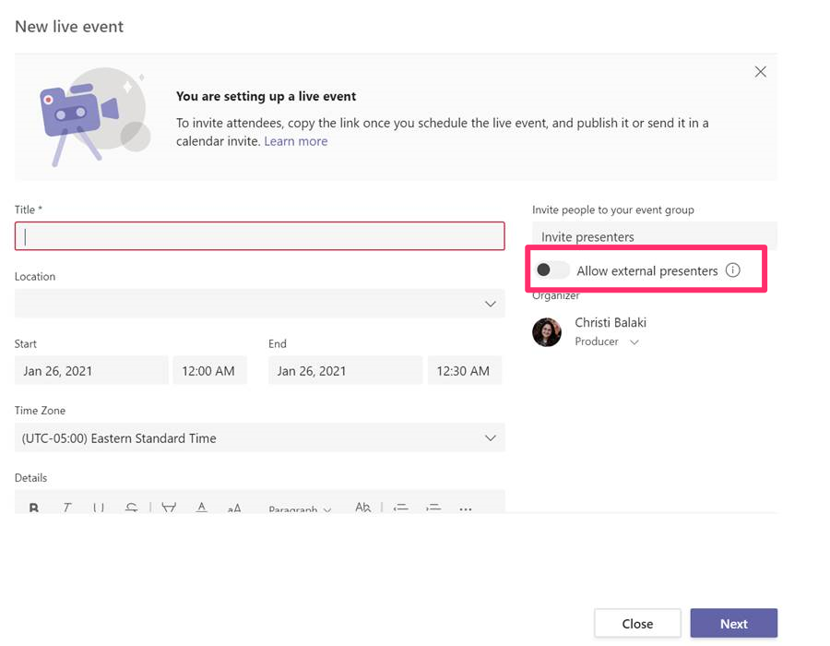
Allowing anonymous presenters in Teams Live Events
Get started with Microsoft Teams live events
Set up for live events in Microsoft Teams
Notes:
This feature is available to tenants with licenses for Teams Live events at no additional charge.

Slide 14
Neuigkeiten in Microsoft Teams
Customized backgrounds in Microsoft Teams meeting video coming to mobile devices (→ April/Mai)
Microsoft Teams Room: share wirelessly from iOS or Android Teams app (→ April)
Allowing anonymous presenters in Teams Live Events (→ Mai)
Join a meeting with digital meeting ID (→ Mai)
Teams live event producers will see a separate window experience for managing events (→ Mai)
Improvements in managing attendee audio in Microsoft Teams Meetings (→ April)
Notes:
Customized Background:
iOS: rollout began early April and should be complete mid-April
Android: rollout begins early May and should be complete mid-May
The feature respects the same policies as desktop backgrounds

Slide 15
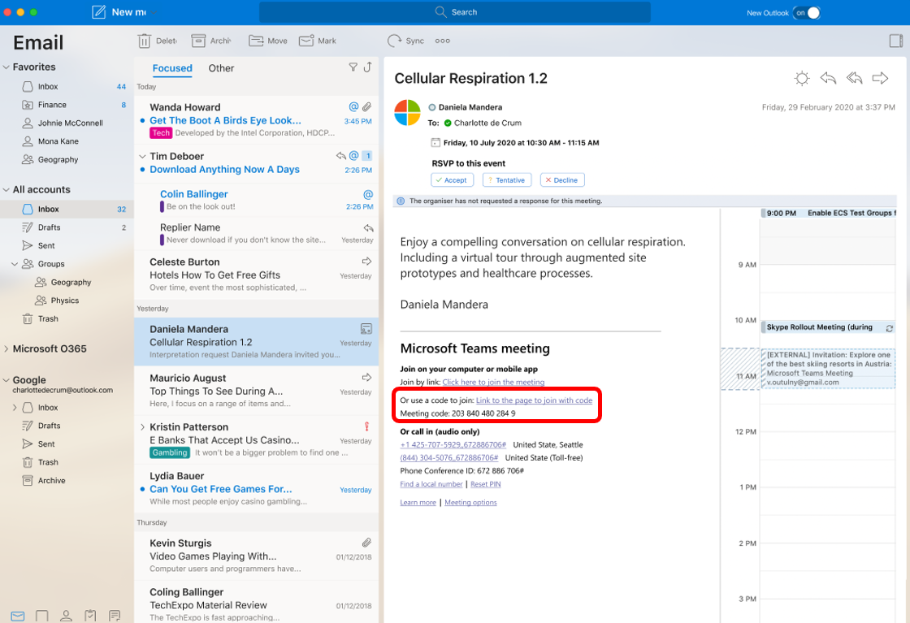
Join a meeting with digital meeting ID

Slide 16
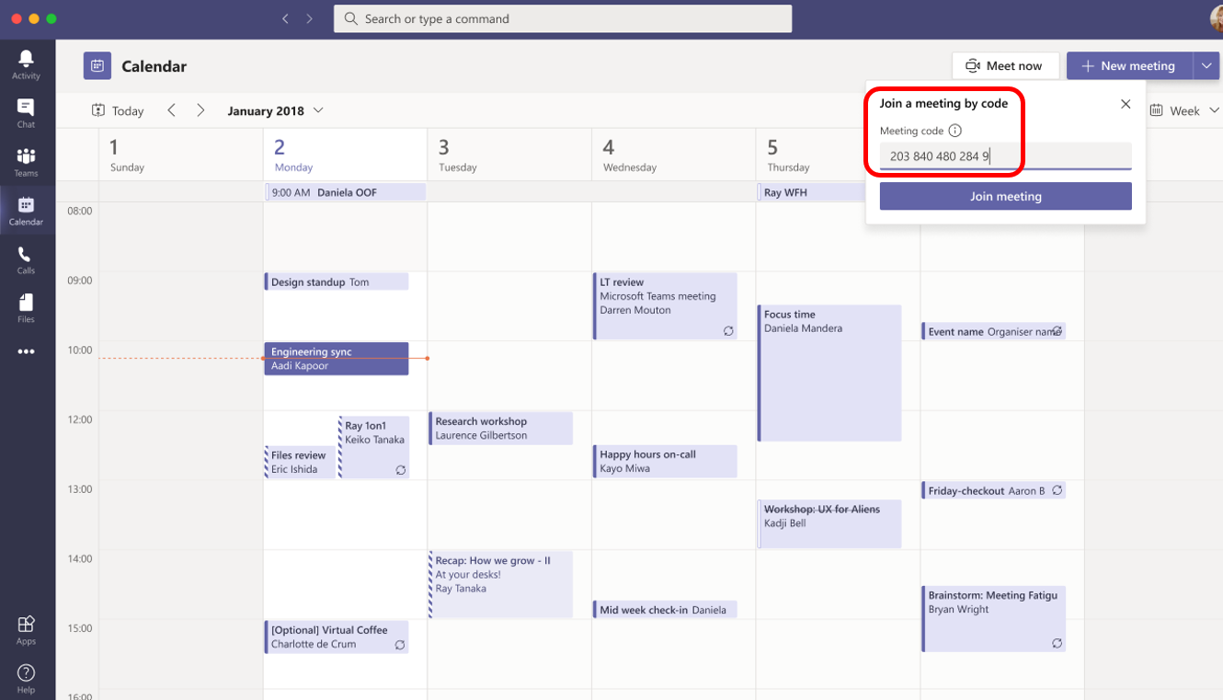
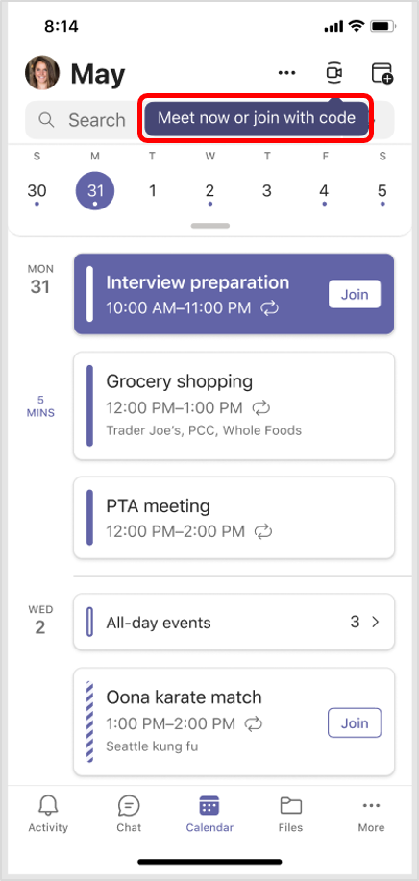
Join a meeting with digital meeting ID

Slide 17
Neuigkeiten in Microsoft Teams
Customized backgrounds in Microsoft Teams meeting video coming to mobile devices (→ April/Mai)
Microsoft Teams Room: share wirelessly from iOS or Android Teams app (→ April)
Allowing anonymous presenters in Teams Live Events (→ Mai)
Join a meeting with digital meeting ID (→ Mai)
Teams live event producers will see a separate window experience for managing events (→ Mai)
Improvements in managing attendee audio in Microsoft Teams Meetings (→ April)
Notes:
Customized Background:
iOS: rollout began early April and should be complete mid-April
Android: rollout begins early May and should be complete mid-May
The feature respects the same policies as desktop backgrounds

Slide 18
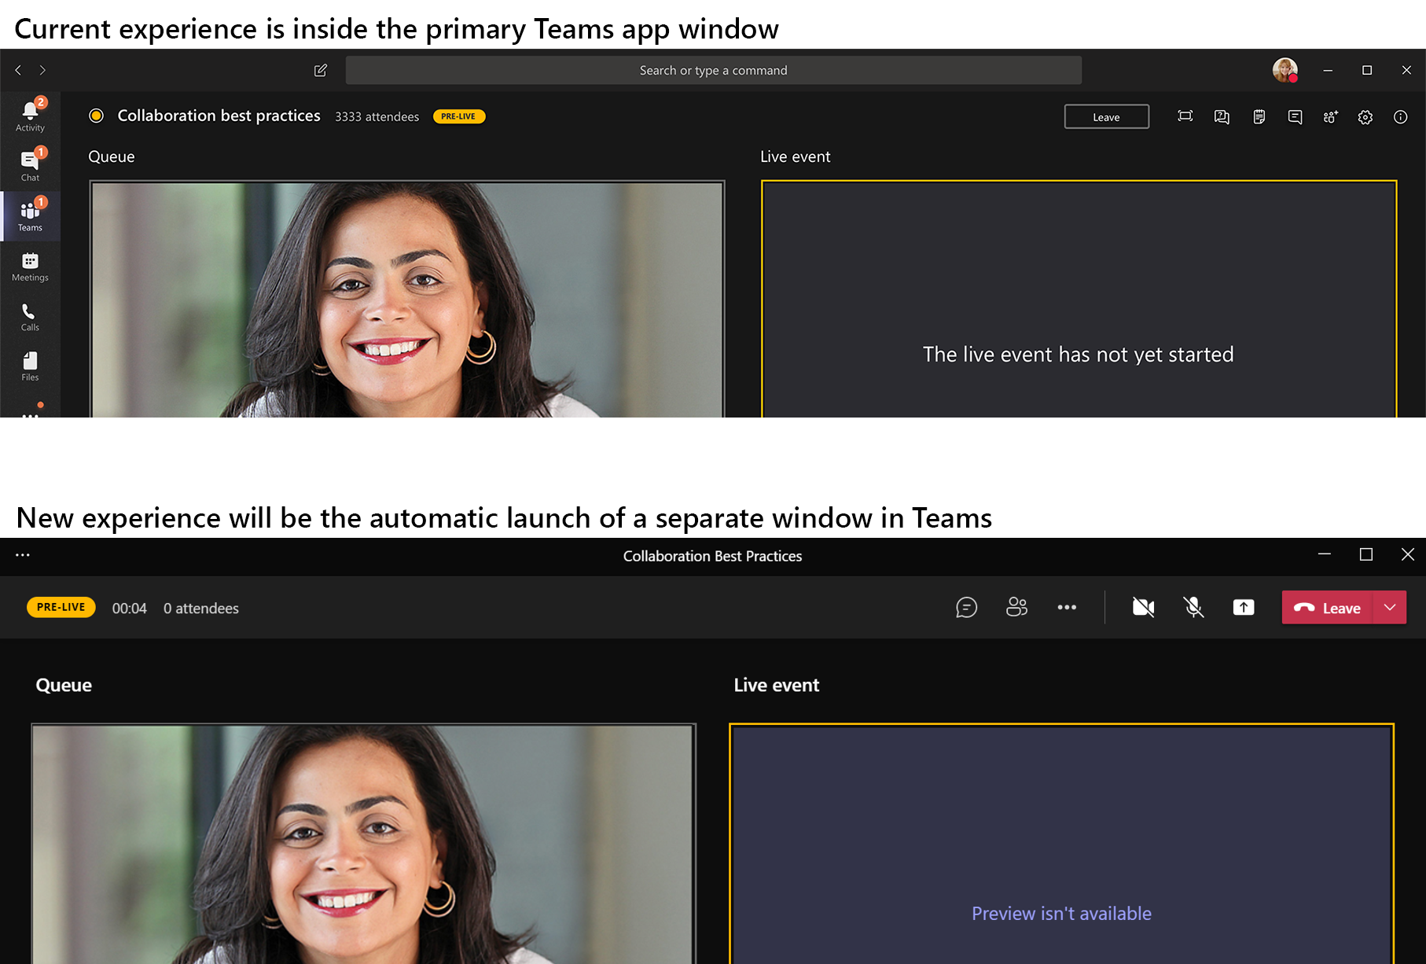
Teams live event producers will see a separate window experience for managing events

Slide 19
Neuigkeiten in Microsoft Teams
Customized backgrounds in Microsoft Teams meeting video coming to mobile devices (→ April/Mai)
Microsoft Teams Room: share wirelessly from iOS or Android Teams app (→ April)
Allowing anonymous presenters in Teams Live Events (→ Mai)
Join a meeting with digital meeting ID (→ Mai)
Teams live event producers will see a separate window experience for managing events (→ Mai)
Improvements in managing attendee audio in Microsoft Teams Meetings (→ April)
Notes:
Customized Background:
iOS: rollout began early April and should be complete mid-April
Android: rollout begins early May and should be complete mid-May
The feature respects the same policies as desktop backgrounds

Slide 20
Neuigkeiten in Microsoft Teams
Microsoft Teams: Windows 10 native notifications in Teams (→ April)
New PowerPoint Live Presentation option with desktop and window sharing (→ Mai)
PowerPoint Live in Teams: Slide Translation (→ April, updated)
New breakout room functionality coming to Microsoft Teams (→ April)
PowerPoint Live: Present to Teams from PowerPoint Web App (→ Mai)
Microsoft Teams: Related Content for Teams Meetings, iOS and Android (→ April)

Slide 21
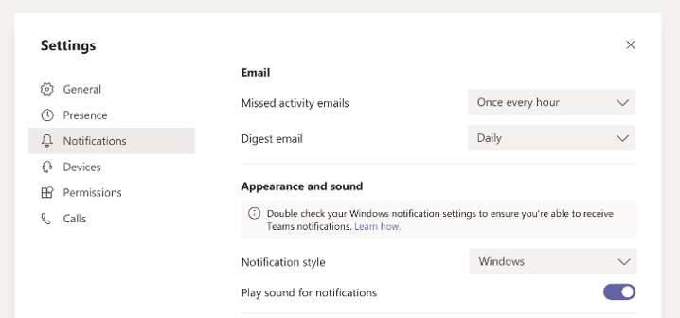
Microsoft Teams: Windows 10 native notifications in Teams

Slide 22
Neuigkeiten in Microsoft Teams
Microsoft Teams: Windows 10 native notifications in Teams (→ April)
New PowerPoint Live Presentation option with desktop and window sharing (→ Mai)
PowerPoint Live in Teams: Slide Translation (→ April, updated)
New breakout room functionality coming to Microsoft Teams (→ April)
PowerPoint Live: Present to Teams from PowerPoint Web App (→ Mai)
Microsoft Teams: Related Content for Teams Meetings, iOS and Android (→ April)

Slide 23
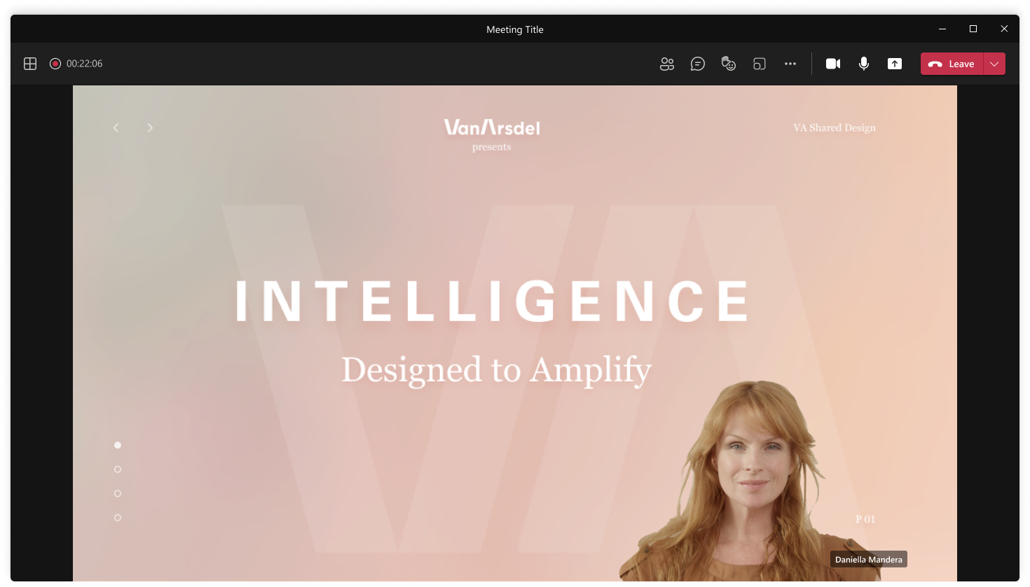
New PowerPoint Live Presentation option with desktop and window sharing
Notes:
Standout mode
This mode appears to meeting participants who are using the Teams desktop or mobile app as well as Teams on the web.

Slide 24
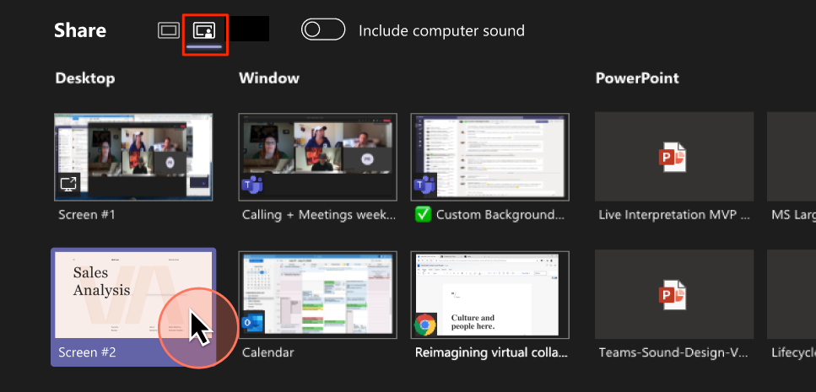
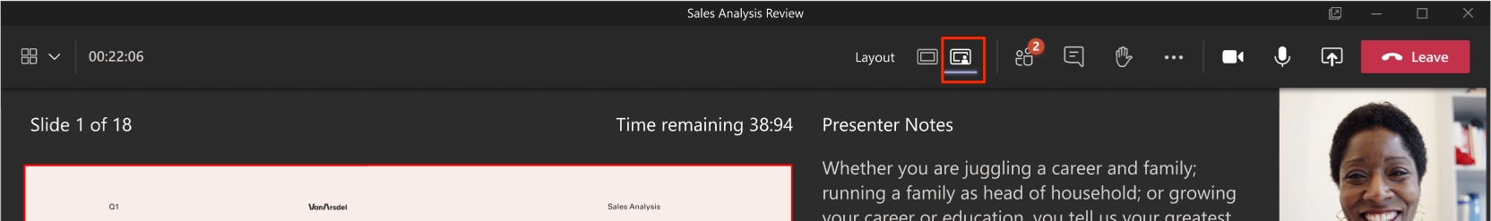
New PowerPoint Live Presentation option with desktop and window sharing
Notes:
Standout mode

Slide 25
Neuigkeiten in Microsoft Teams
Microsoft Teams: Windows 10 native notifications in Teams (→ April)
New PowerPoint Live Presentation option with desktop and window sharing (→ Mai)
PowerPoint Live in Teams: Slide Translation (→ April, updated)
New breakout room functionality coming to Microsoft Teams (→ April)
PowerPoint Live: Present to Teams from PowerPoint Web App (→ Mai)
Microsoft Teams: Related Content for Teams Meetings, iOS and Android (→ April)

Slide 26
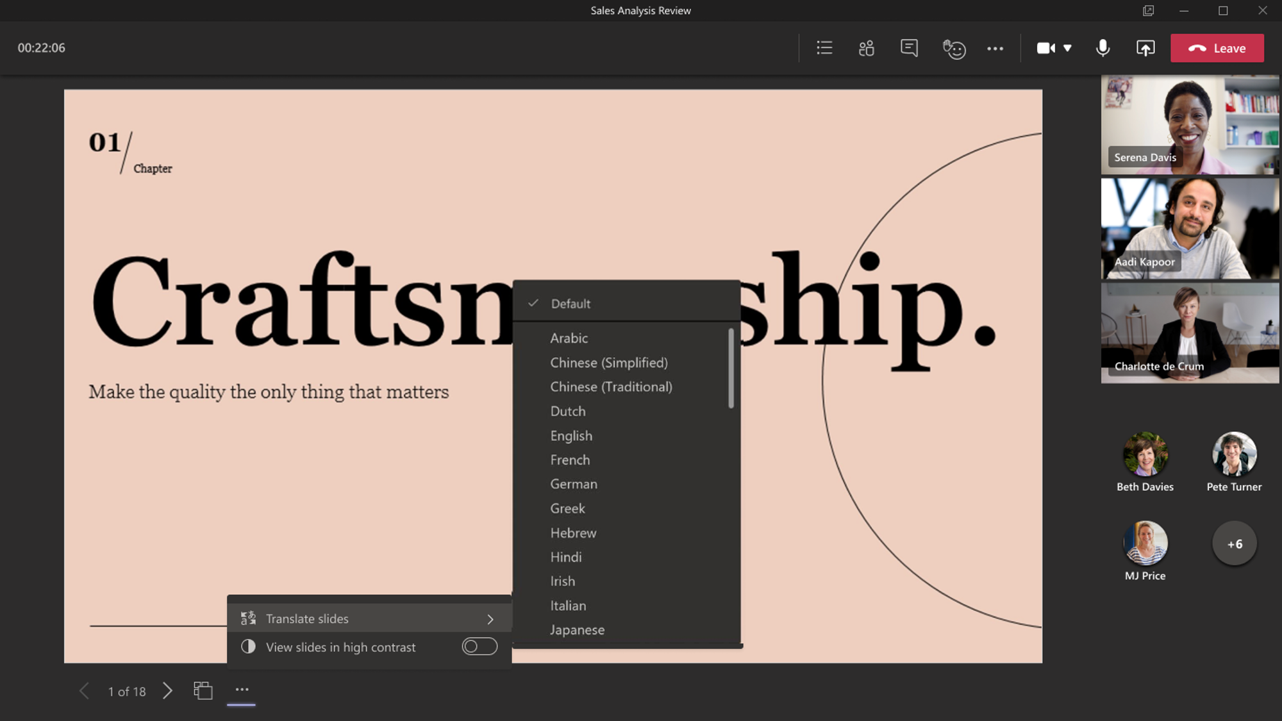
PowerPoint Live in Teams: Slide Translation

Slide 27
PowerPoint Live in Teams: Slide Translation
Arabisch | Französisch | Irisch | Russisch
Chinesisch (Simplified) | Deutsch | Italienisch | Spanisch
Chinesisch (Traditional) | Griechisch | Japanisch | Thailändisch
Holländisch | Hebräisch | Koreanisch | Türkisch
Englisch | Hindi | Portugiesisch

Slide 28
Neuigkeiten in Microsoft Teams
Microsoft Teams: Windows 10 native notifications in Teams (→ April)
New PowerPoint Live Presentation option with desktop and window sharing (→ Mai)
PowerPoint Live in Teams: Slide Translation (→ April, updated)
New breakout room functionality coming to Microsoft Teams (→ April)
PowerPoint Live: Present to Teams from PowerPoint Web App (→ Mai)
Microsoft Teams: Related Content for Teams Meetings, iOS and Android (→ April)

Slide 29
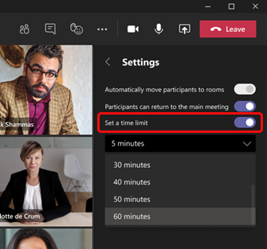
New breakout room functionality coming to Microsoft Teams
Room assignment retention (Default)
Participant reassignment while rooms are open
Set timers for breakout sessions
https://admin.microsoft.com/Adminportal/Home#/MessageCenter/:/messages/MC247659

Slide 30
Neuigkeiten in Microsoft Teams
Microsoft Teams: Windows 10 native notifications in Teams (→ April)
New PowerPoint Live Presentation option with desktop and window sharing (→ Mai)
PowerPoint Live in Teams: Slide Translation (→ April, updated)
New breakout room functionality coming to Microsoft Teams (→ April)
PowerPoint Live: Present to Teams from PowerPoint Web App (→ Mai)
Microsoft Teams: Related Content for Teams Meetings, iOS and Android (→ April)

Slide 31
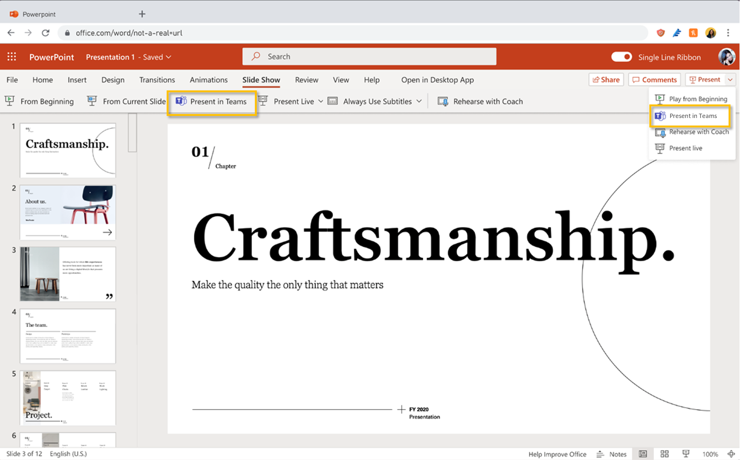
PowerPoint Live: Present to Teams from PowerPoint Web App

Slide 32
Neuigkeiten in Microsoft Teams
Microsoft Teams: Windows 10 native notifications in Teams (→ April)
New PowerPoint Live Presentation option with desktop and window sharing (→ Mai)
PowerPoint Live in Teams: Slide Translation (→ April, updated)
New breakout room functionality coming to Microsoft Teams (→ April)
PowerPoint Live: Present to Teams from PowerPoint Web App (→ Mai)
Microsoft Teams: Related Content for Teams Meetings, iOS and Android (→ April)

Slide 33
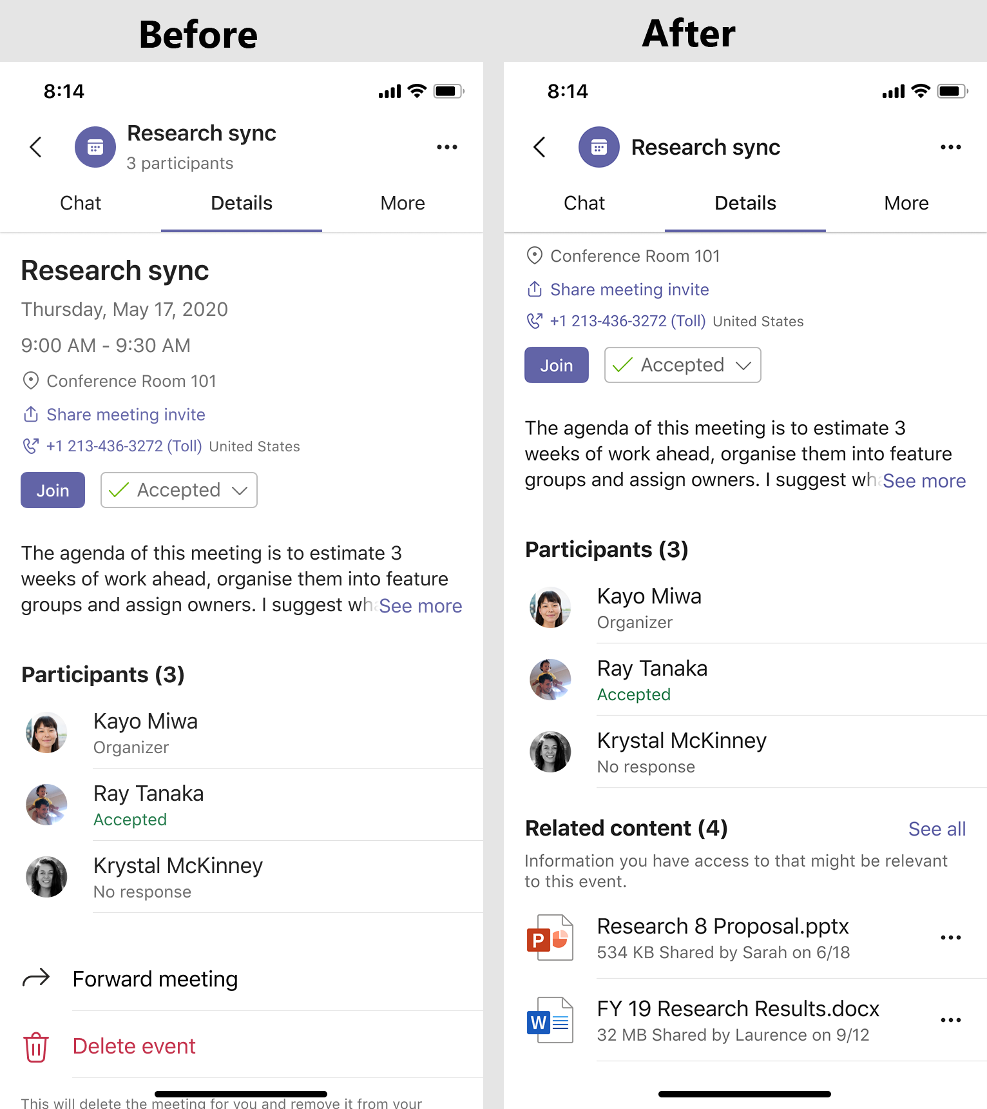
Microsoft Teams: Related Content for Teams Meetings (iOS and Android)

Slide 34
Neuigkeiten in Microsoft Teams
New experience of the Participant roster (→ März)
Improved search experience in the participant roster (→ April)
Supervised Chat for Teams private chats (→ Mai)
Voice-Enabled Channels - Collaborative Calling (→April)
Multiple Spotlights coming to Teams meetings (→ April)
Expanded emoji picker in Microsoft Teams (→ Mai)
Call Merge (→ April)
Date/time format matches Mac and Windows OS language settings (→ April)
Notes:
Voice-enabled channels
This is default off and no action is required unless you want to configure a new Voice-Enabled Channel.

Slide 35
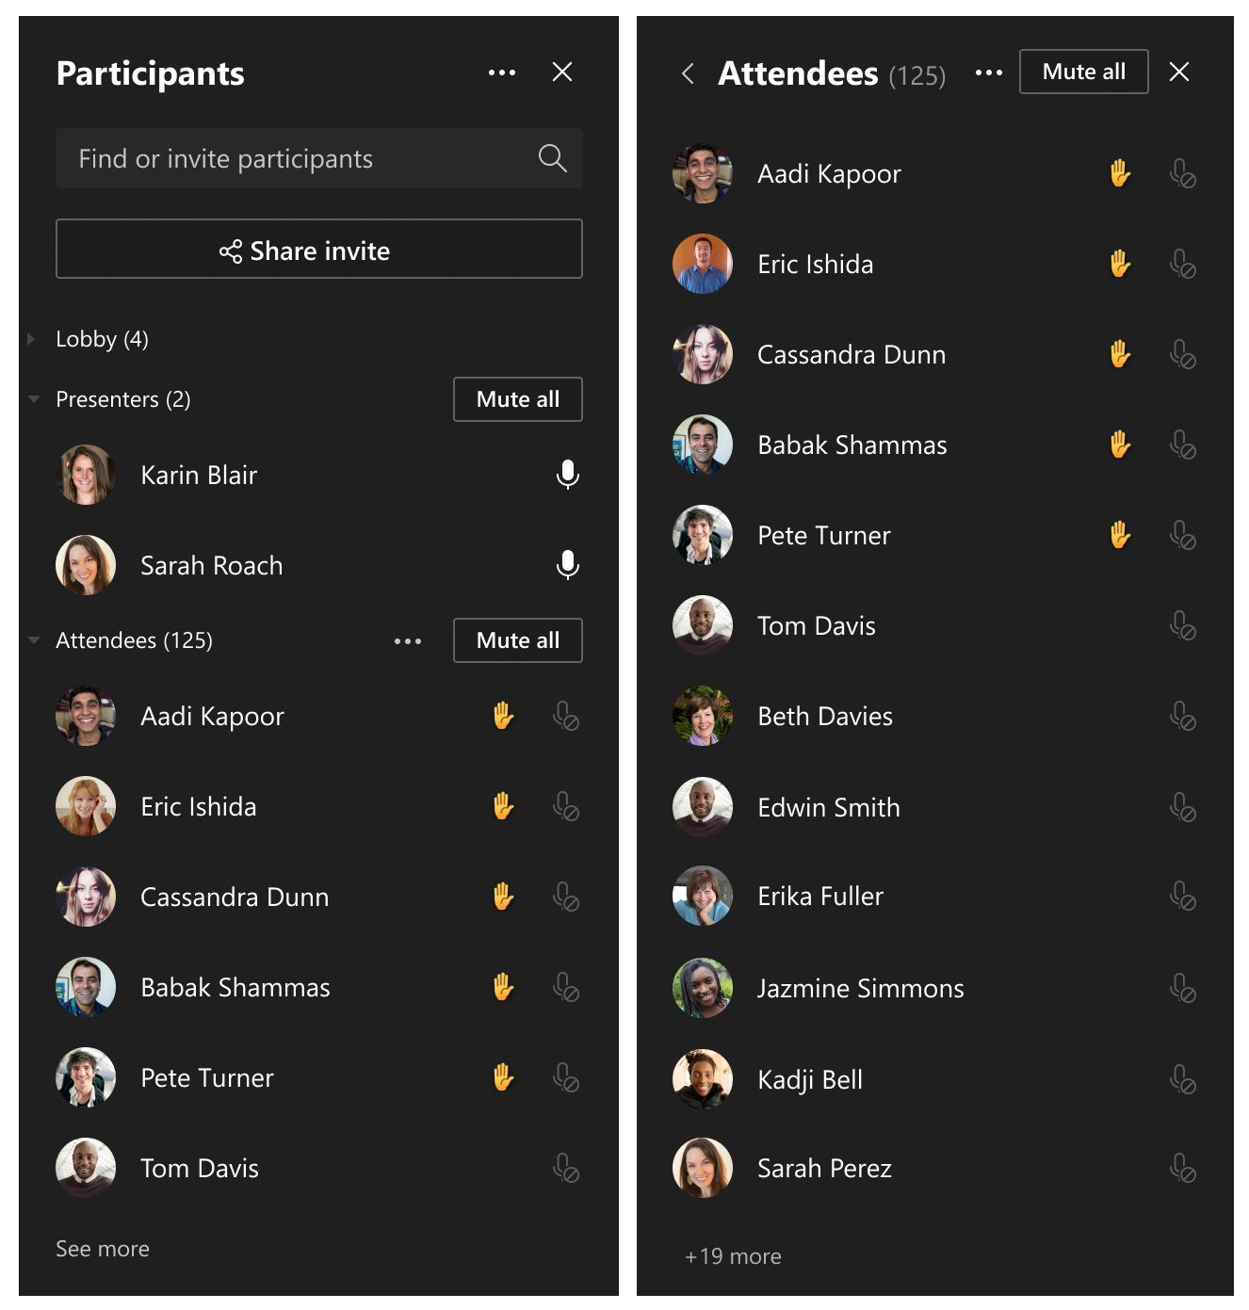
New experience of the Participant roster
Anpassung der Anzeige der Lobby, Teilnehmern, Presenter
Anzeige von 20 Personen
Detailansicht von bis 260 der aktivsten Teilnehmer, in alphabetischer Sortierung

Slide 36
Neuigkeiten in Microsoft Teams
New experience of the Participant roster (→ März)
Improved search experience in the participant roster (→ April)
Supervised Chat for Teams private chats (→ Mai)
Voice-Enabled Channels - Collaborative Calling (→April)
Multiple Spotlights coming to Teams meetings (→ April)
Expanded emoji picker in Microsoft Teams (→ Mai)
Call Merge (→ April)
Date/time format matches Mac and Windows OS language settings (→ April)
Notes:
Voice-enabled channels
This is default off and no action is required unless you want to configure a new Voice-Enabled Channel.

Slide 37
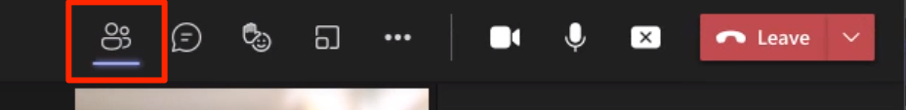
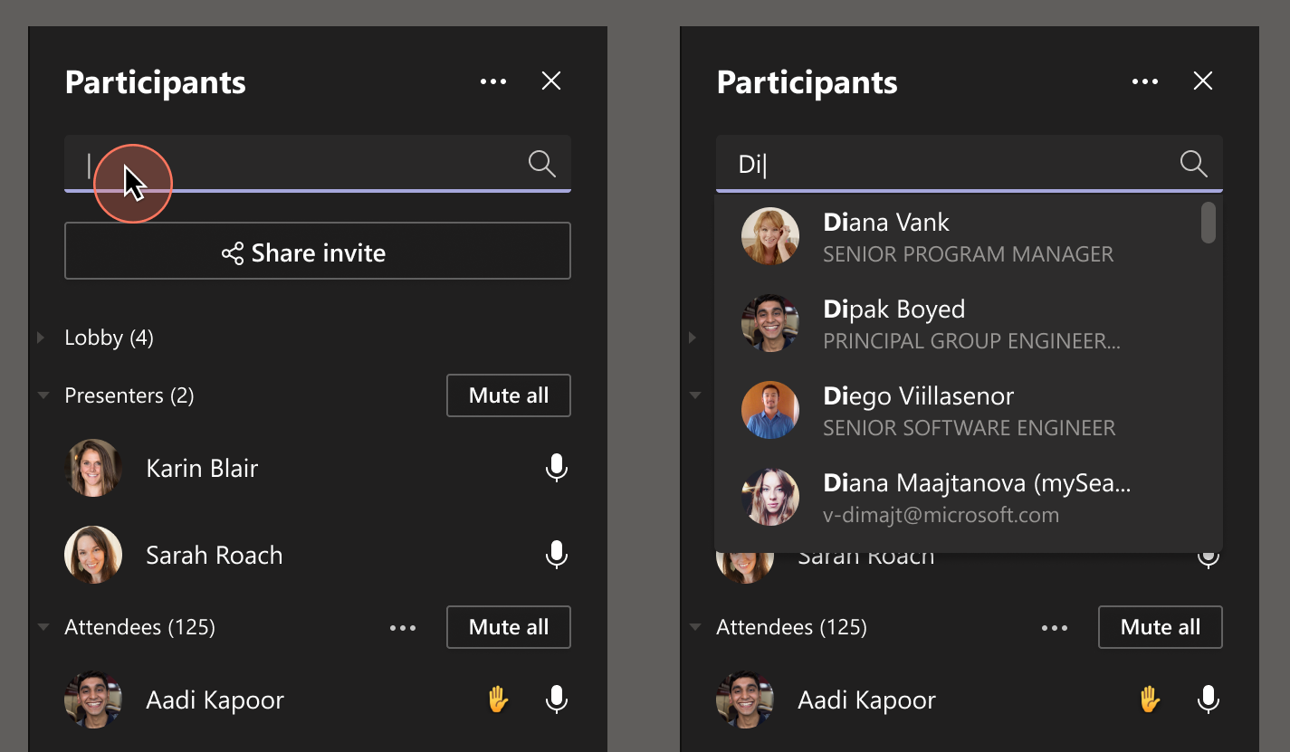
Improved search experience in the participant roster

Slide 38
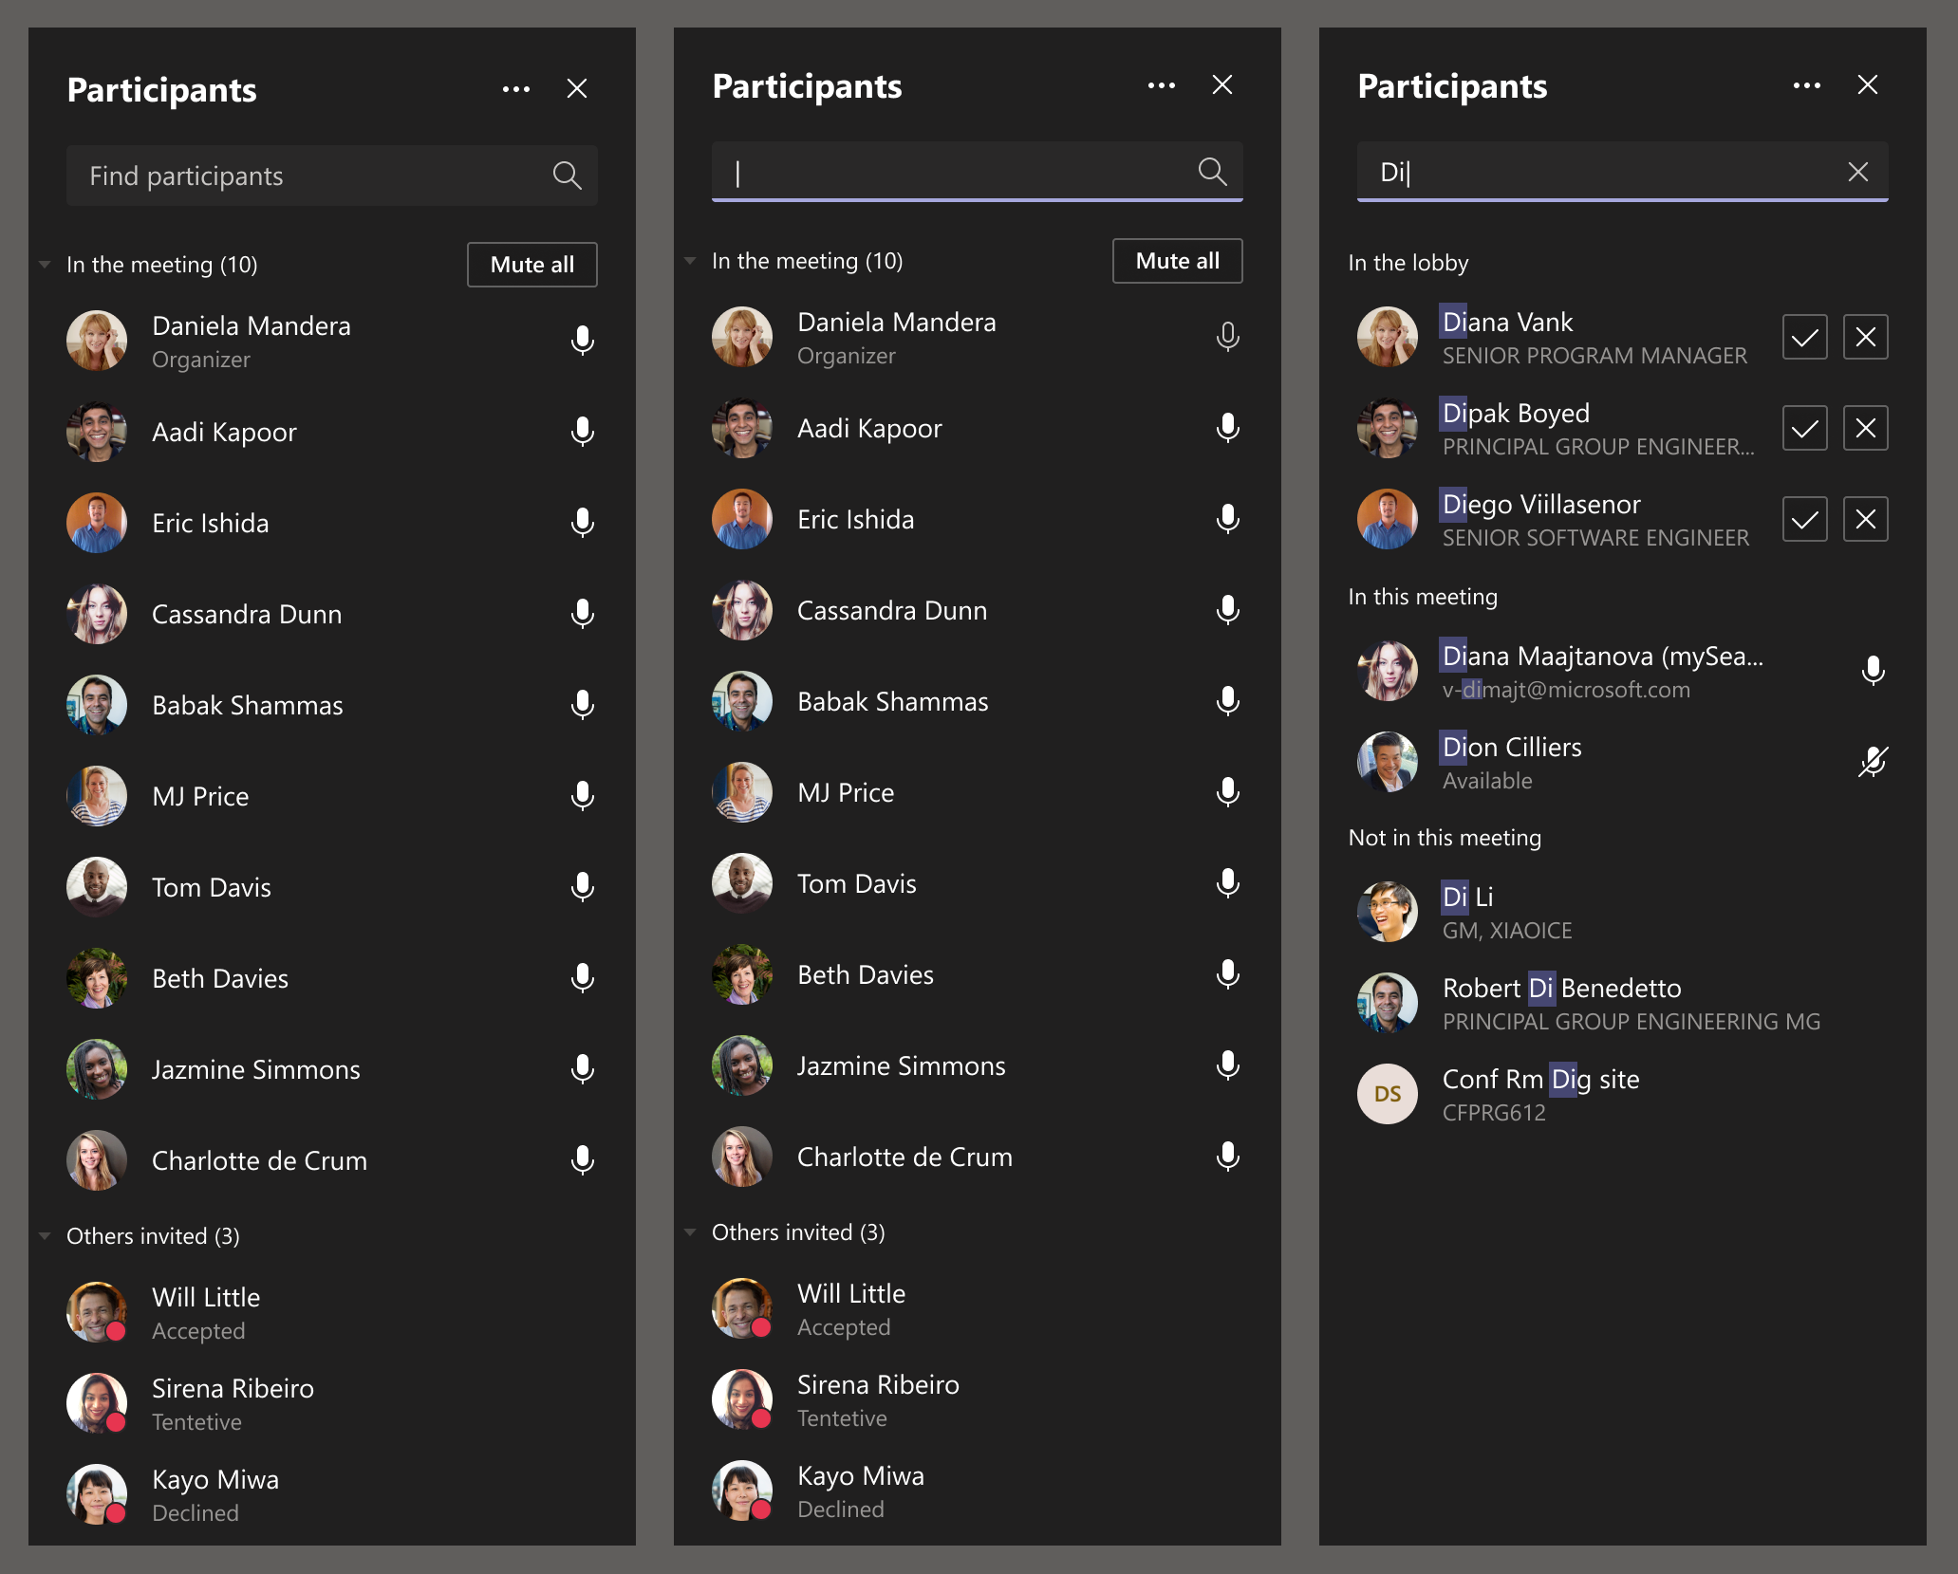
Improved search experience in the participant roster

Slide 39
Neuigkeiten in Microsoft Teams
New experience of the Participant roster (→ März)
Improved search experience in the participant roster (→ April)
Supervised Chat for Teams private chats (→ Mai)
Voice-Enabled Channels - Collaborative Calling (→April)
Multiple Spotlights coming to Teams meetings (→ April)
Expanded emoji picker in Microsoft Teams (→ Mai)
Call Merge (→ April)
Date/time format matches Mac and Windows OS language settings (→ April)
Notes:
Voice-enabled channels
This is default off and no action is required unless you want to configure a new Voice-Enabled Channel.

Slide 40
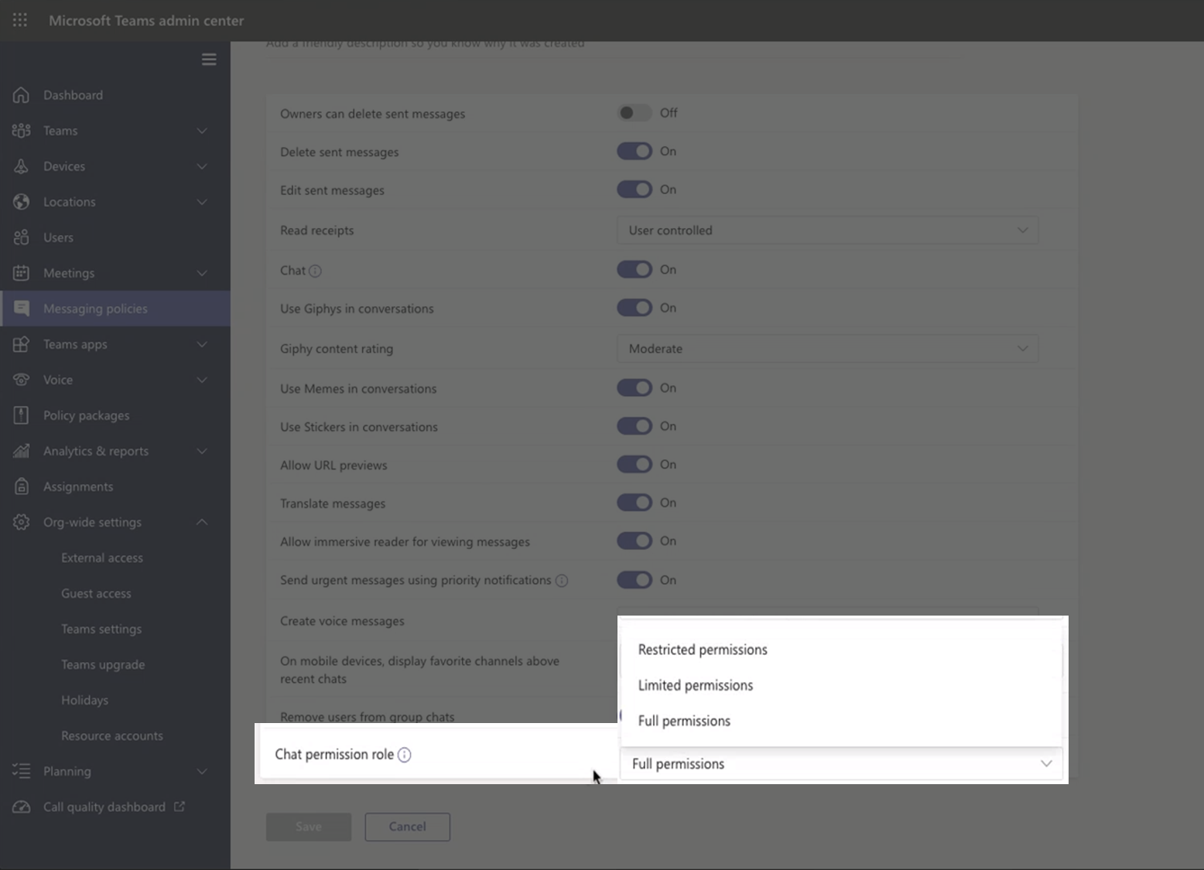
Supervised Chat for Teams private chats
Notes:
Supervised Chat blocks restricted users from starting new chats unless an appropriate supervisor is present. When chat supervision is enabled, supervisors aren't allowed to leave chats and other participants aren't allowed to remove them ensuring that all chats are properly supervised.
Supervised chats in Microsoft Teams for Education

Slide 41
Neuigkeiten in Microsoft Teams
New experience of the Participant roster (→ März)
Improved search experience in the participant roster (→ April)
Supervised Chat for Teams private chats (→ Mai)
Voice-Enabled Channels - Collaborative Calling (→April)
Multiple Spotlights coming to Teams meetings (→ April)
Expanded emoji picker in Microsoft Teams (→ Mai)
Call Merge (→ April)
Date/time format matches Mac and Windows OS language settings (→ April)
Notes:
Voice-enabled channels
This is default off and no action is required unless you want to configure a new Voice-Enabled Channel.

Slide 42
Neuigkeiten in Microsoft Teams
New experience of the Participant roster (→ März)
Improved search experience in the participant roster (→ April)
Supervised Chat for Teams private chats (→ Mai)
Voice-Enabled Channels - Collaborative Calling (→April)
Multiple Spotlights coming to Teams meetings (→ April)
Expanded emoji picker in Microsoft Teams (→ Mai)
Call Merge (→ April)
Date/time format matches Mac and Windows OS language settings (→ April)
Notes:
Voice-enabled channels
This is default off and no action is required unless you want to configure a new Voice-Enabled Channel.

Slide 43
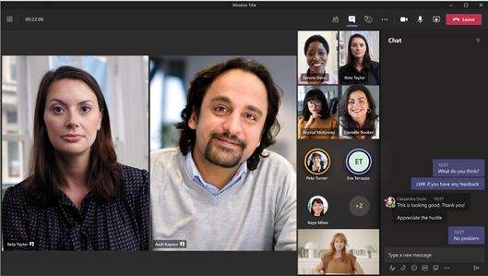
Multiple Spotlights coming to Teams meetings
Spotlight-Aktivierung im Kontextmenü der Teilnehmerliste
Spotlight-Deaktivierung für einzelne Spotlights oder alle
Maximal 7 parallele Spotlights

Slide 44
Neuigkeiten in Microsoft Teams
New experience of the Participant roster (→ März)
Improved search experience in the participant roster (→ April)
Supervised Chat for Teams private chats (→ Mai)
Voice-Enabled Channels - Collaborative Calling (→April)
Multiple Spotlights coming to Teams meetings (→ April)
Expanded emoji picker in Microsoft Teams (→ Mai)
Call Merge (→ April)
Date/time format matches Mac and Windows OS language settings (→ April)
Notes:
Voice-enabled channels
This is default off and no action is required unless you want to configure a new Voice-Enabled Channel.

Slide 45
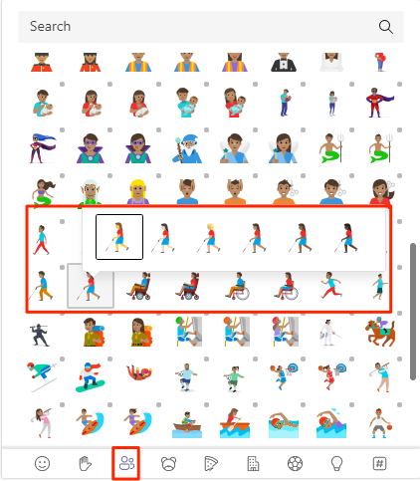
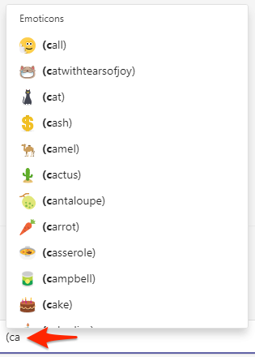
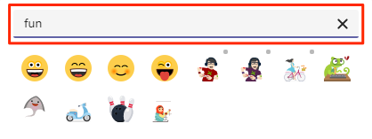
Expanded emoji picker in Microsoft Teams
Notes:
from 85 emojis to more than 800

Slide 46
Neuigkeiten in Microsoft Teams
New experience of the Participant roster (→ März)
Improved search experience in the participant roster (→ April)
Supervised Chat for Teams private chats (→ Mai)
Voice-Enabled Channels - Collaborative Calling (→April)
Multiple Spotlights coming to Teams meetings (→ April)
Expanded emoji picker in Microsoft Teams (→ Mai)
Call Merge (→ April)
Date/time format matches Mac and Windows OS language settings (→ April)
Notes:
Voice-enabled channels
This is default off and no action is required unless you want to configure a new Voice-Enabled Channel.

Slide 47
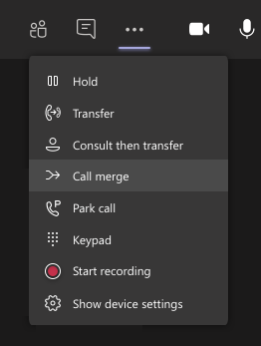
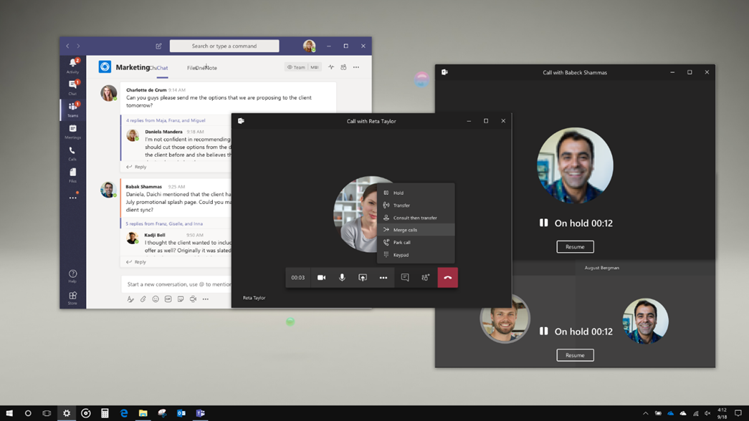
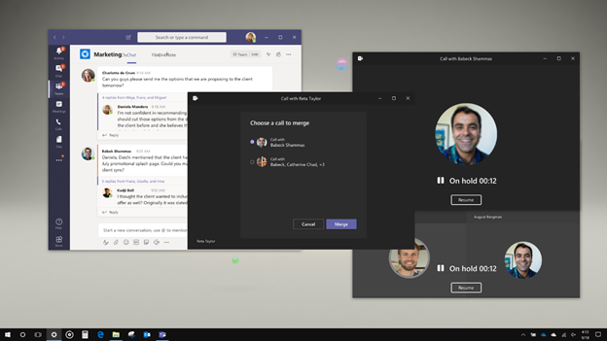
Call Merge

Slide 48
Neuigkeiten in Microsoft Teams
New experience of the Participant roster (→ März)
Improved search experience in the participant roster (→ April)
Supervised Chat for Teams private chats (→ Mai)
Voice-Enabled Channels - Collaborative Calling (→April)
Multiple Spotlights coming to Teams meetings (→ April)
Expanded emoji picker in Microsoft Teams (→ Mai)
Call Merge (→ April)
Date/time format matches Mac and Windows OS language settings (→ April)
Notes:
Voice-enabled channels
This is default off and no action is required unless you want to configure a new Voice-Enabled Channel.

Slide 49
Neuigkeiten in Microsoft Teams
Supporting outgoing video in Safari (→ März)
Increasing interactive meeting participants and chat from 300 to 1000 (→ April, updated)
New features in Teams polls in meetings (→ April)
Viva Connections for Microsoft Teams desktop clients (→ März)
Notes:
Only for users of MacOS and Safari 14 or higher

Slide 50
Neuigkeiten in Microsoft Teams
Supporting outgoing video in Safari (→ März)
Increasing interactive meeting participants and chat from 300 to 1000 (→ April, updated)
New features in Teams polls in meetings (→ April)
Viva Connections for Microsoft Teams desktop clients (→ März)
Notes:
Only for users of MacOS and Safari 14 or higher

Slide 51
Neuigkeiten in Microsoft Teams
Supporting outgoing video in Safari (→ März)
Increasing interactive meeting participants and chat from 300 to 1000 (→ April, updated)
New features in Teams polls in meetings (→ April)
Viva Connections for Microsoft Teams desktop clients (→ März)
Notes:
Only for users of MacOS and Safari 14 or higher

Slide 52
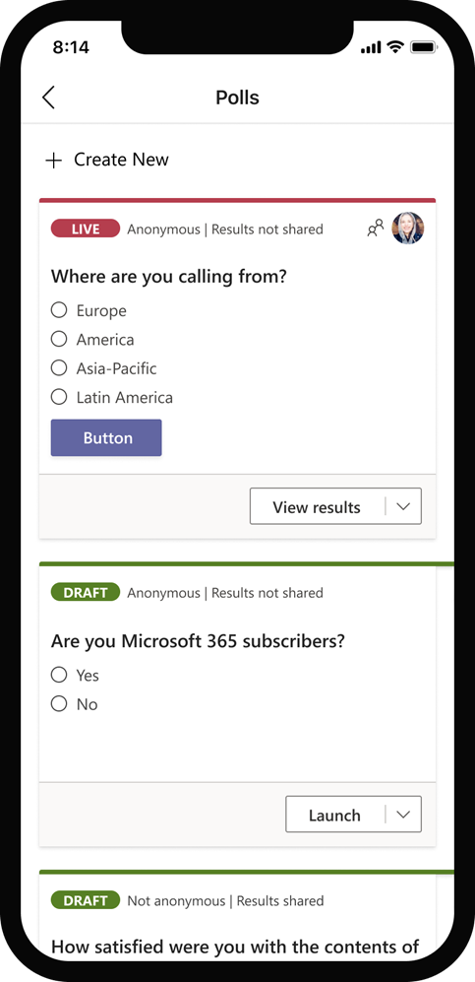
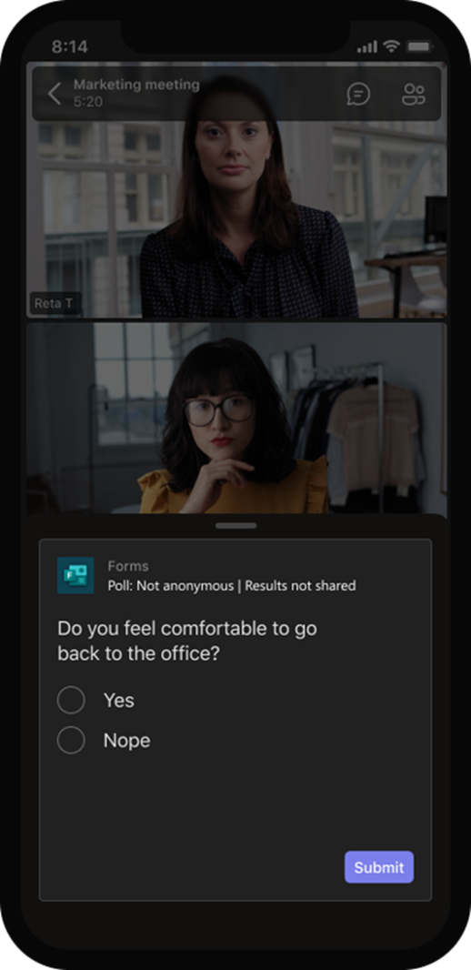
New features in Teams polls in meetings
Anonyme Teilnehmer können abstimmen
Umfrage-Erstellung auch im Mobile Client möglich
Change participant settings for a Teams meeting
Create a poll and then launch it before, during, or after your meeting
Create a Poll in Microsoft Teams
Poll attendees during a Teams meeting
Notes:
If you do not want presenters in your tenant to be able to poll meeting attendees using the Forms app, you will need to block the app in the Microsoft Teams admin center.

Slide 53
Neuigkeiten in Microsoft Teams
Supporting outgoing video in Safari (→ März)
Increasing interactive meeting participants and chat from 300 to 1000 (→ April, updated)
New features in Teams polls in meetings (→ April)
Viva Connections for Microsoft Teams desktop clients (→ März)
Notes:
Only for users of MacOS and Safari 14 or higher

Slide 54
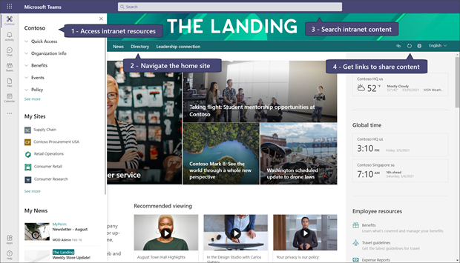
Viva Connections for Microsoft Teams desktop clients

Slide 55
Was ist neu in Teams – für Administratoren
Microsoft Teams: introducing organization-wide backgrounds (→ April/Mai)
De-identify personally identifiable information in Teams admin usage reports (Update)
Opt-in to the new Teams live events multi-window producer experience
https://admin.microsoft.com/Adminportal/Home#/MessageCenter/:/messages/MC249608
GoLocal support for Live Events
Announcing a new service plan, Teams Pro (→ März)

Slide 56
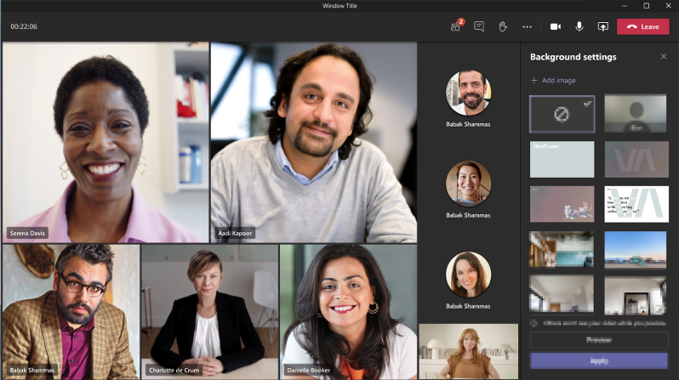
Microsoft Teams: introducing organization-wide backgrounds

Slide 57
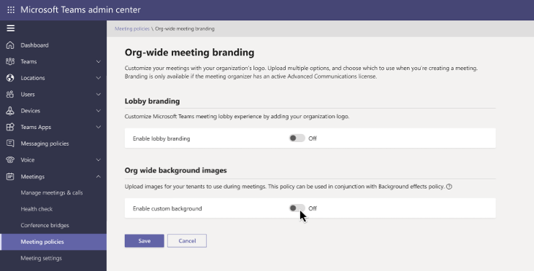
Microsoft Teams: introducing organization-wide backgrounds
Erfordert eine Advanced Communications Lizenz bei Go-Live
Ohne Lizenz werden alle Konfigurationen der Preview-Phase entfernt
PNG-/JPG-Bilder mit 360x360px bis 2048x2048px
Maximal 50 Hintergrundbilder im Mandanten

Slide 58
Was ist neu in Teams – für Administratoren
Microsoft Teams: introducing organization-wide backgrounds (→ April/Mai)
De-identify personally identifiable information in Teams admin usage reports (Update)
Opt-in to the new Teams live events multi-window producer experience
https://admin.microsoft.com/Adminportal/Home#/MessageCenter/:/messages/MC249608
GoLocal support for Live Events
Announcing a new service plan, Teams Pro (→ März)

Slide 59
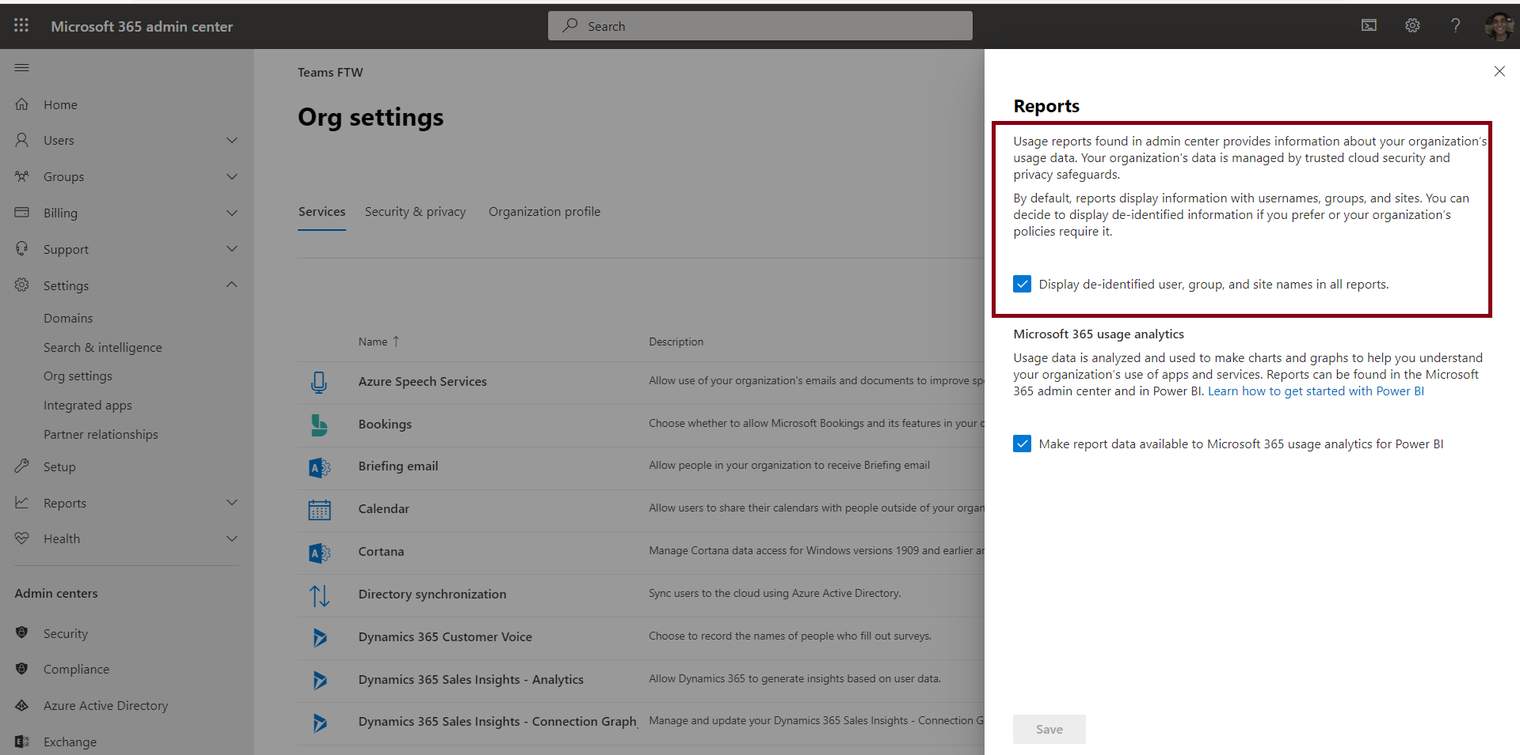
De-identify personally identifiable information in Teams admin usage reports
Details: https://admin.microsoft.com/Adminportal/Home#/MessageCenter/:/messages/MC244599
Notes:
https://admin.microsoft.com/Adminportal/Home#/MessageCenter/:/messages/MC244599

Slide 60
Was ist neu in Teams – für Administratoren
Microsoft Teams: introducing organization-wide backgrounds (→ April/Mai)
De-identify personally identifiable information in Teams admin usage reports (Update)
Opt-in to the new Teams live events multi-window producer experience
https://admin.microsoft.com/Adminportal/Home#/MessageCenter/:/messages/MC249608
GoLocal support for Live Events
Announcing a new service plan, Teams Pro (→ März)

Slide 61
Was ist neu in Teams – für Administratoren
Microsoft Teams: introducing organization-wide backgrounds (→ April/Mai)
De-identify personally identifiable information in Teams admin usage reports (Update)
Opt-in to the new Teams live events multi-window producer experience
https://admin.microsoft.com/Adminportal/Home#/MessageCenter/:/messages/MC249608
GoLocal support for Live Events
Announcing a new service plan, Teams Pro (→ März)
Notes:
GoLocal
If you were previously enabled to use Live Events but did not have GoLocal Support in your country, we will not automatically migrate your existing Teams Live Events to your home country. Your data will continue to be hosted in the regional datacenter.
If you would like to use your country’s GoLocal datacenter instead of your regional datacenter, please contact support directly to formally request the change in datacenter.

Slide 62
Was ist neu in Teams – für Administratoren
Microsoft Teams: introducing organization-wide backgrounds (→ April/Mai)
De-identify personally identifiable information in Teams admin usage reports (Update)
Opt-in to the new Teams live events multi-window producer experience
https://admin.microsoft.com/Adminportal/Home#/MessageCenter/:/messages/MC249608
GoLocal support for Live Events
Announcing a new service plan, Teams Pro (→ März)

Slide 63
Announcing a new service plan, Teams Pro
Automatisch hinzugefügt und verfügbar für folgende Lizenzpläne
Office 365 E5/E3/A5/A3
Microsoft 365 Business Standard/Business Premium
Ermöglicht die Nutzung kommender Funktionen im Microsoft Teams Pro Plan

Slide 64
Was ist neu in Teams – für Administratoren
Improvements in managing attendee audio in Microsoft Teams Meetings (→ April)
Customize apps in Microsoft Teams (→ April)
Dokumentation
Teams for your personal life banners (→ April)
Dokumentation
Updating Teams live event 'Never record' recording policy (→ April)
Dokumentation
Third party electronic signatures in the Teams Approvals app (→ April)

Slide 65
Was ist neu in Teams – für Administratoren
Improvements in managing attendee audio in Microsoft Teams Meetings (→ April)
Customize apps in Microsoft Teams (→ April)
Dokumentation
Teams for your personal life banners (→ April)
Dokumentation
Updating Teams live event 'Never record' recording policy (→ April)
Dokumentation
Third party electronic signatures in the Teams Approvals app (→ April)

Slide 66
Was ist neu in Teams – für Administratoren
Improvements in managing attendee audio in Microsoft Teams Meetings (→ April)
Customize apps in Microsoft Teams (→ April)
Dokumentation
Teams for your personal life banners (→ April)
Dokumentation
Updating Teams live event 'Never record' recording policy (→ April)
Dokumentation
Third party electronic signatures in the Teams Approvals app (→ April)
Notes:
Teams for your personal life banners
Banner im Activity Feed

Slide 67
Was ist neu in Teams – für Administratoren
Improvements in managing attendee audio in Microsoft Teams Meetings (→ April)
Customize apps in Microsoft Teams (→ April)
Dokumentation
Teams for your personal life banners (→ April)
Dokumentation
Updating Teams live event 'Never record' recording policy (→ April)
Dokumentation
Third party electronic signatures in the Teams Approvals app (→ April)
Notes:
Teams for your personal life banners
Banner im Activity Feed

Slide 68
Was ist neu in Teams – für Administratoren
Improvements in managing attendee audio in Microsoft Teams Meetings (→ April)
Customize apps in Microsoft Teams (→ April)
Dokumentation
Teams for your personal life banners (→ April)
Dokumentation
Updating Teams live event 'Never record' recording policy (→ April)
Dokumentation
Third party electronic signatures in the Teams Approvals app (→ April)
Notes:
Teams for your personal life banners
Banner im Activity Feed

Slide 69
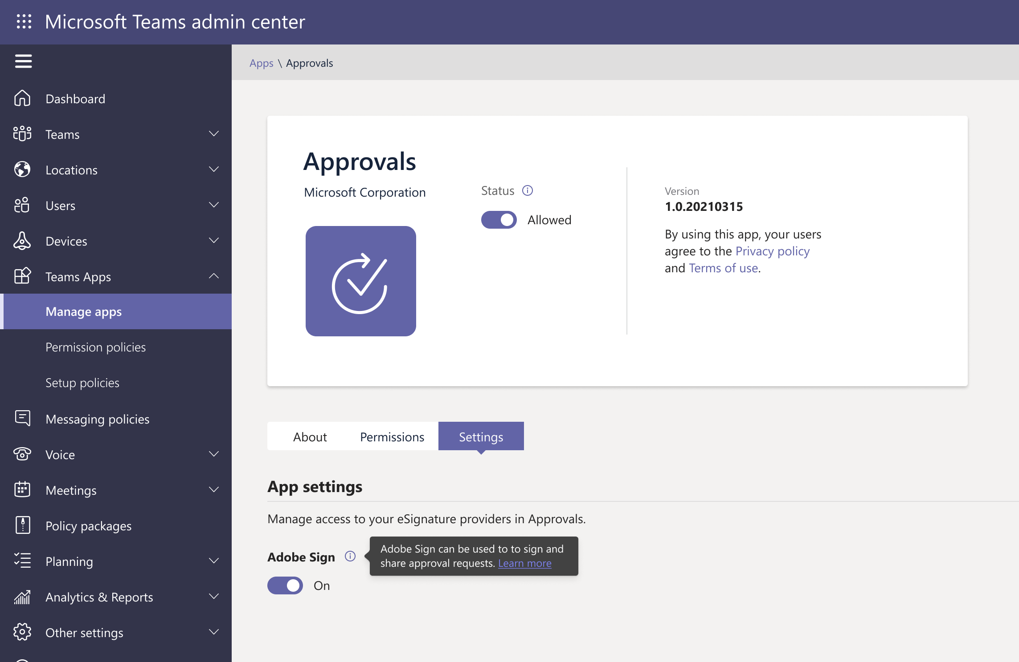
Third party electronic signatures in the Teams Approvals app
Notes:
Adobe Sign supported
DocuSign soon

Slide 70
Was ist neu in Teams – für Administratoren
Create and use approval templates in the Teams Approvals app (→ April)
Dokumentation
Allow only organization participants to bypass the meeting lobby (→ April)
Manage Auto-Claim Policies for products containing Microsoft Teams (→ GA)
Dokumentation

Slide 71

Create and use approval templates in the Teams Approvals app

Slide 72
Was ist neu in Teams – für Administratoren
Create and use approval templates in the Teams Approvals app (→ April)
Dokumentation
Allow only organization participants to bypass the meeting lobby (→ April)
Manage Auto-Claim Policies for products containing Microsoft Teams (→ GA)
Dokumentation

Slide 73
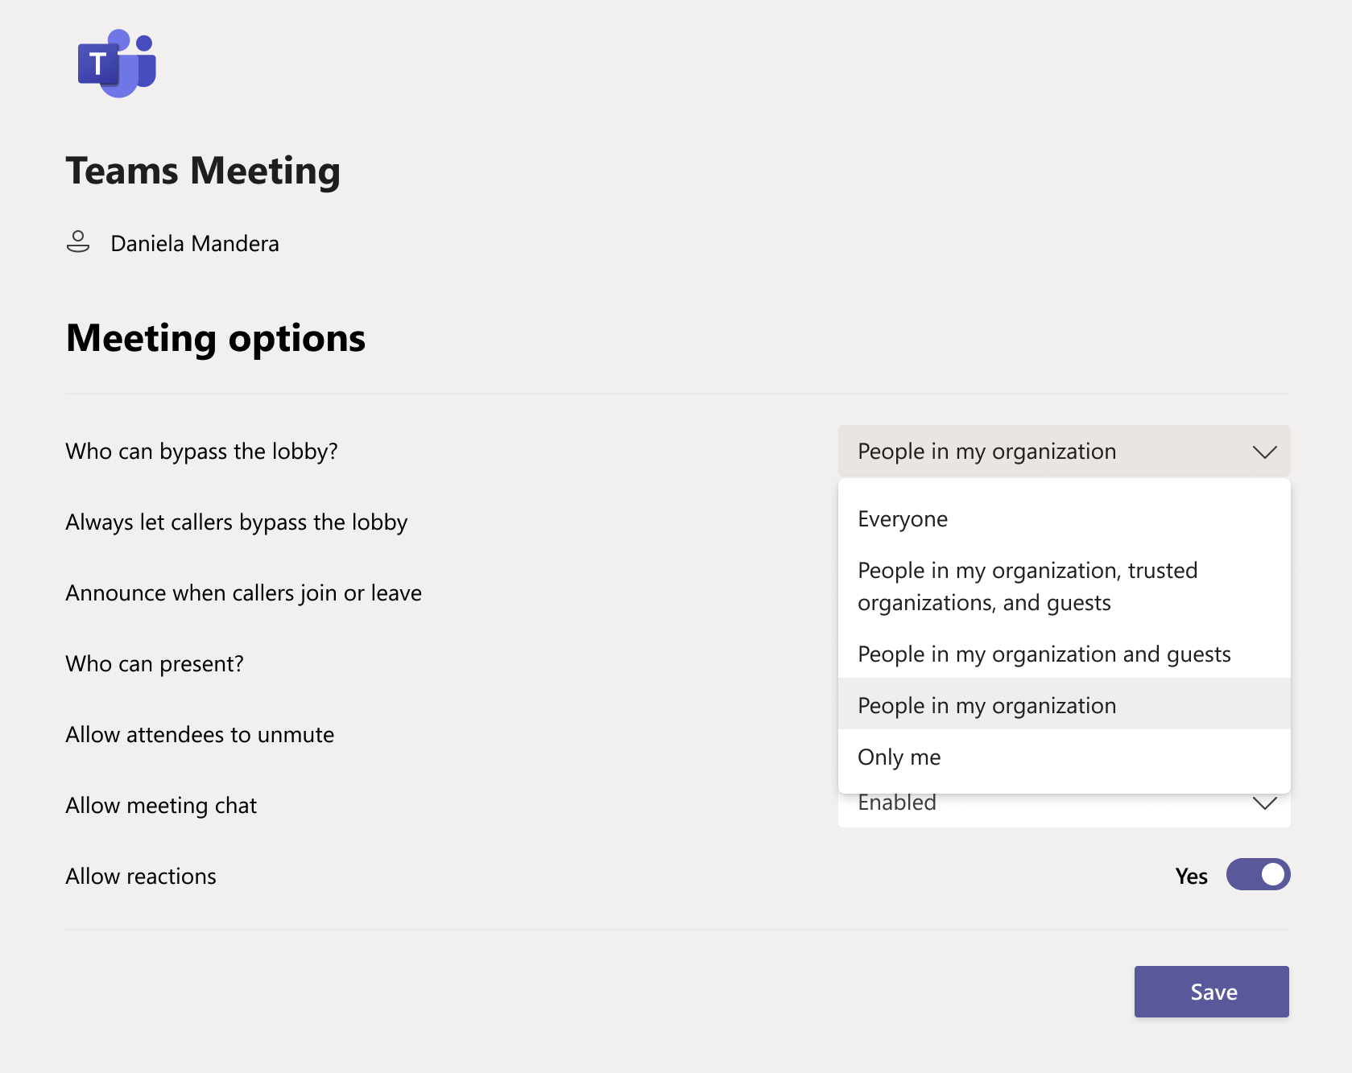
Allow only organization participants to bypass the meeting lobby

Slide 74
Was ist neu in Teams – für Administratoren
Create and use approval templates in the Teams Approvals app (→ April)
Dokumentation
Allow only organization participants to bypass the meeting lobby (→ April)
Manage Auto-Claim Policies for products containing Microsoft Teams (→ GA)
Dokumentation
Notes:
Auto-Claim
By default, the auto-claim policy feature is turned off.

Slide 75
Was ist neu in Teams – Der Blog
What’s New in Microsoft Teams | February and March 2021
What's New in Microsoft Teams | Microsoft Ignite 2021 - Microsoft Tech Community
Microsoft Teams Blog

Slide 76
Microsoft Teams Administration vereinfachen mit PowerShell und ScriptRunner
Heiko Brenn @HeikoBrenn

Slide 77
Organisatorisches

Slide 78
Organisatorisches
Microsoft Community Tenant für User Groups
Microsoft 365 Gast-Konten für User Group Mitglieder
Anmeldung: https://go.granikos.eu/TeamsUGForm
Einheitlicher Teams Meeting Teilnahme-Link
https://teamsusergroup.berlin/meetup

Slide 79
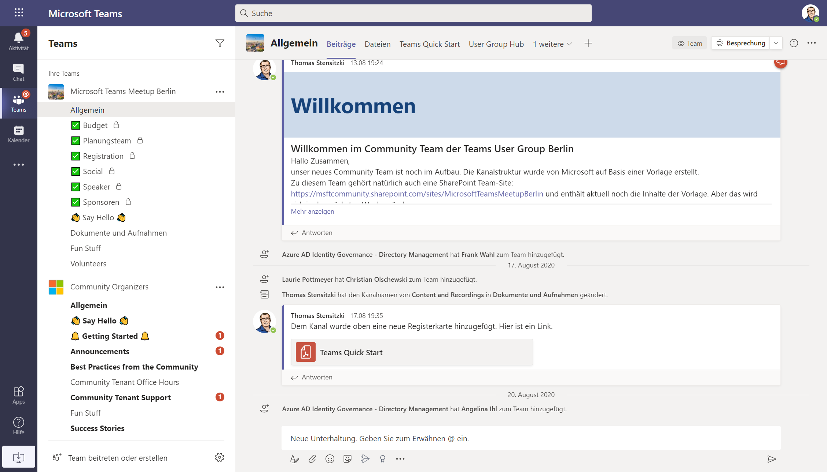

Slide 80

Vielen Dank für eure Teilnahme!
Das nächste Meetup:
→ 10. Juni 2021
https://TeamsUserGroup.Berlin
Spread the Word!
#TeamsUGBerlin
Aufzeichnungen unserer Meetups sind im Community Team verfügbar.

Slide 81
Offene Diskussion

